Slide 1
CTF Introduction & Overview
By
Naveen Selvan

Slide 2
Whoami - Naveen Selvan
Reverse Engineer
CTF Miner
Malware Researcher
M.Tech Cys Amrita Alumni

Slide 3
Index
CTF Introduction
Types of CTF
Bug Bounty & CTF
Domain Selection
Real Life Job Examples
Team Play
CTF Resource List
CTF Website
Book Reference
Challenges Hands On
Questions
Contact

Slide 4
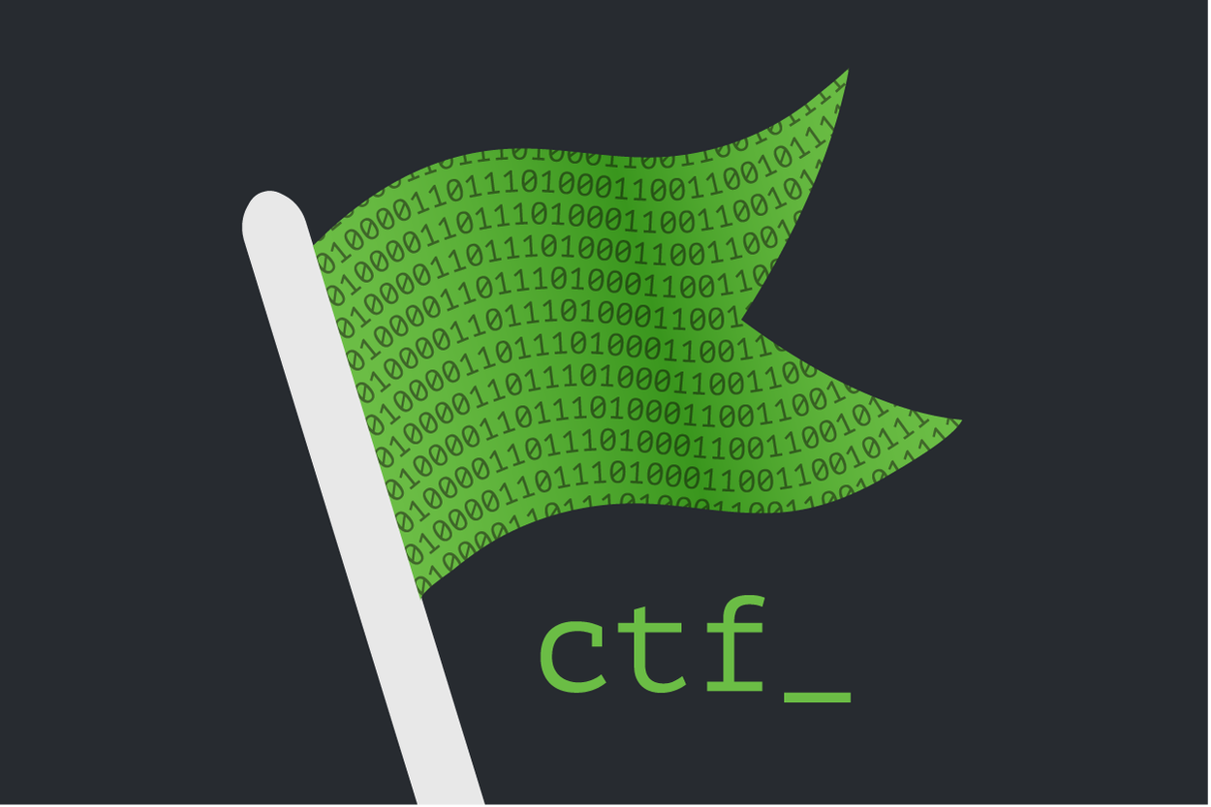
Capture The Flag ( CTF)
Solve challenges on different domains of Cyber Security
Dig Deeper & Obtain the flag
Example: FLAG{Test_Flag}
Team Play
Creative Thinking
Puzzle Solving Skills
Practice Real Life Cyber Security Challenges

Slide 5
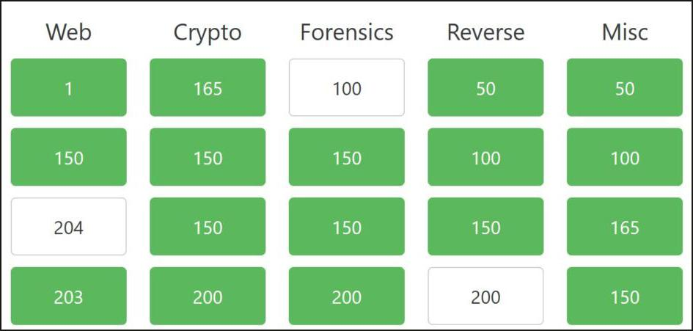
Types of CTF
Jeopardy
Reverse Engineering
Crypto
Web
Forensics
Binary Exploitation
Attack-Defense
Exploit/Patch
Jeopardy
Team 1
Team 2
Exploit/Patch Vulnerability
Attack Defense

Slide 6
Bug Bounty & CTF
CTF
Practice & Improve Cyber Security Skills
Bug Bounty
Use your acquired knowledge to find vulnerabilities
Report Vulnerabilities for rewards
Bin Exploitation Vulnerabilities https://cve.mitre.org/
Example CVE-2021-3064
https://www.bugcrowd.com/bug-bounty-list/

Slide 7
Domain Selection
Cryptography - Transformation of messages Mathematics Involved
Forensics - Investigation
Web - Web Attacks
Reverse Engineering - Low Level System Function
Binary Exploitation - Find Vulnerabilities & Exploit

Slide 8
Real Life Job Examples
Cryptography - Blockchain Developer - Cryptography
Forensics - Forensics Cyber Security Analyst
Web - Security Analyst
Reverse Engineering - Malware Researcher
Exploitation - Vulnerability Researcher, Security Engineer

Slide 9
Team Play
https://ctftime.org/
Open to All https://ctftime.org/team/9135
Anokha https://ctftime.org/team/51667
Jackdaw https://ctftime.org/team/13597
Follow writeups after each competition https://ctftime.org/writeups

Slide 10
CTF Resource List
https://wiki.bi0s.in/
http://ctfs.github.io/resources/
https://trailofbits.github.io/ctf/forensics/
https://github.com/teambi0s/InCTF/
https://github.com/naveenselvan/xiomara2k18
https://ctftime.org/event/580

Slide 11
CTF Website
https://cybertalents.com/
https://www.root-me.org/en/Capture-The-Flag/CTF-all-the-day/
https://training.majorleaguecyber.org/

Slide 12
How to Get Started
Choose a domain
Choose one scripting language to automate & simplify the challenge
Example : Python
Participate in CTF Time as a Team
Read Published Writeups
Start more exploration on one domain
Participate in CTF War Games

Slide 13
Book Reference
Reverse Engineering
Practical Reverse Engineering: X86, X64, ARM, Windows Kernel, Reversing Tools, and Obfuscation
Exploitation
Hacking: The Art of Exploitation
Cryptography
https://github.com/ashutosh1206/Crypton
List of tools to use https://github.com/apsdehal/awesome-ctf

Slide 14

Challenges Hands On
Challenges walk through on each domain

Slide 15
Contact
https://twitter.com/infantnaveen
E-mail : infantnaveen13@gmail.com
Linkedin https://in.linkedin.com/in/naveenselvan

Slide 16

Questions

